Slide 1
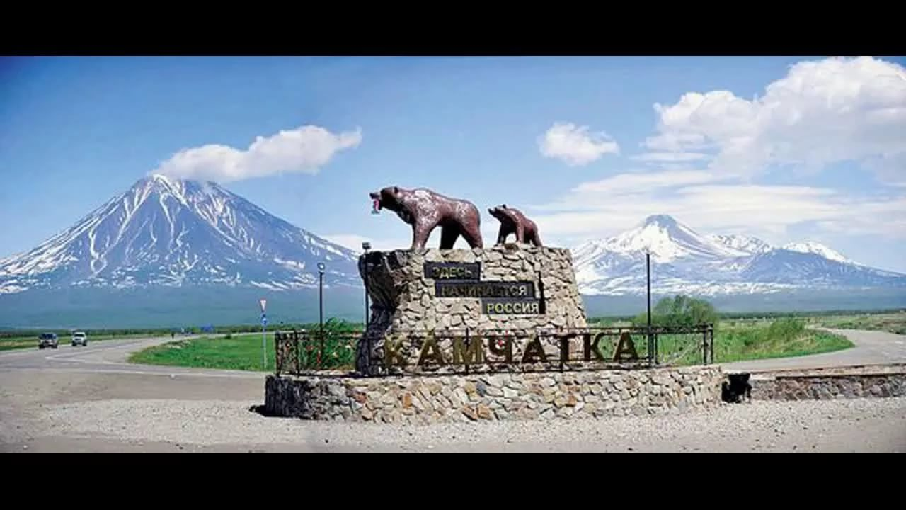
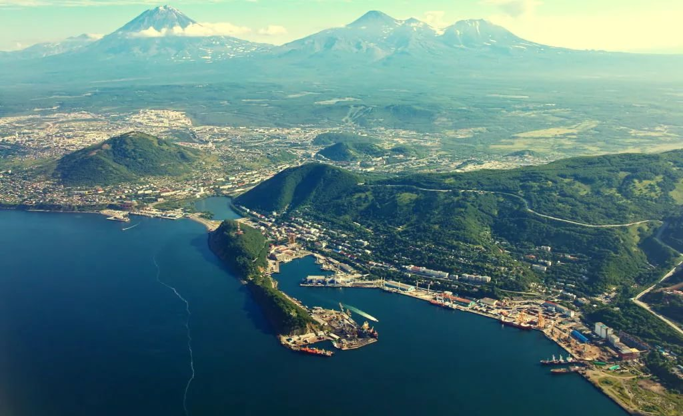
MEDICAL TOURISM IN KAMCHATKA KRAI
ABOUT HOW TO OBTAIN HEALTH
CARE IN THE KAMCHATKA REGION

Slide 2
2
CONTENT
What is treatment in Kamchatka кrai ……………………………......3-6
I stage: choice of medical organization in Kamchatka Krai…….......7-9
II stage: sending a request for treatment to a medical organization..................................................................................10-11
III stage: accommodation and transport........................................12-15
IV stage: visa processing ….........................................................16-20
V stage: Welcome to Russia! ........................................................21-22
Contacts............................................................................................23
Materials prepared
Coordinating center development
of export of medical services

Slide 3
3
WHAT IS THE TREATMENT
IN KAMCHATKA KRAI?

Slide 4
4
TREATMENT IN THE KAMCHATKA REGION IS
HIGH
QUALITY
BEST
DOCTORS
AVAILABLE PRICE
ACQUAINTANCE
WITH THE CULTURE REGION'S
High-quality medical care
that meets
international standards
Qualified medical
specialists with
international practice
Competitive cost of
medical services
of all profiles
You will readwith the
sights of the country
and national traditions

Slide 5
5
PROVIDING MEDICAL CARE
In the Russian Federation, you can get medical care in outpatient and inpatient settings.
Help in choosing the conditions of treatment the patient is provided by a medical organization in accordance with the patient's request.
AMBULATORY
STATIONARILY
GET TESTED (CHECK-UP)
FOR 1-2 DAYS AT
THE TIME OF HIS TOURIST
TRIP into Russia
SELECT A MEDICAL ORGANIZATION AT THEIR PROFILE AND COME IN RUSSIA FOR PLANNED HOSPITALIZATION
FIND OUT MORE ON THE WEBSITE OF SELECTED MEDICAL ORGANIZATIONS
FIND OUT MORE ON THE WEBSITE OF SELECTED MEDICAL ORGANIZATIONS

Slide 6
6
HOW TO OBTAIN MEDICAL CARE IN THE KAMCHATKA REGION
I stage:
Choose a medical organization
II stage:
Reach with the medical organization to receive confirmation
III stage:
To choose the type of accommodation and transportation
IV stage:
To apply for a visa
V stage:
Welcome to Russia!

Slide 7
7
I STEP
SELECT A MEDICAL ORGANIZATION ACCORDING TO YOUR HEALTH PROFILE

Slide 8
8
PROFILES MEDICAL CARE AND MEDICAL CENTERS KAMCHATKA TERRITORY
CARDIOVASCULAR SURGERY AND CARDIOLOGY
OPHTHALMOLOGY
GYNECOLOGY
AND OBSTETRICS
GBUZ «Kamchatka regional hospital. A. S. Lukashevskogo»
http://kam-hospital.ru
GBUZ «Kamchatka regional hospital. A. S. Lukashevskogo»
http://kam-hospital.ru
Petropavlovsk-Kamchatsky
GBUZ «Kamchatka regional maternity hospital» http://groddom1.ru
TRAUMATOLOGY AND ORTHOPEDICS
Petropavlovsk-Kamchatsky
КАРДИОЛОГИЯ
Petropavlovsk-Kamchatsky
GBUZ КК «Petropavlovsk-Kamchatskaya city hospital № 2»
http://pkgb2.ru
NEUROLOGY AND NEUROSURGERY
GBUZ «Kamchatka regional hospital. A. S. Lukashevskogo»
http://kam-hospital.ru
Petropavlovsk-Kamchatsky
GBUZ «Kamchatka regional hospital. A. S. Lukashevskogo»
http://kam-hospital.ru
Petropavlovsk-Kamchatsky
CHILD HEALTH
GBUZ КК «Petropavlovsk-Kamchatskaya city hospital № 2»
http://pkgb2.ru
Petropavlovsk-Kamchatsky
GBUZ «Kamchatka regional children's hospital» http://guz-kkdb.ru
Petropavlovsk-Kamchatsky
Petropavlovsk-Kamchatsky

Slide 9
9
PROFILES MEDICAL CARE AND MEDICAL CENTERS KAMCHATKA TERRITORY
MEDICAL
REHABILITATION
ORAL AND MAXILLOFACIAL SURGERY
ПРОФПАТОЛОГИЯ
ONCOLOGY
GBUZ «Kamchatka regional hospital. A. S. Lukashevskogo»
http://kam-hospital.ru
GBUZ «Kamchatka regional Oncology center»
https://kamonco.ru
GBUZ КК «Petropavlovsk-Kamchatskaya city polyclinic № 3»
http://kamgp3.ru
ГБУЗ КК «Petropavlovsk-Kamchatsky city hospital №2»
http://pkgb2.ru
Sanatorium «Pearl Of Kamchatka»
http://жемчужина-камчатки.рус
Petropavlovsk-Kamchatsky
Petropavlovsk-Kamchatsky
Petropavlovsk-Kamchatsky
UROLOGY
Occupational PATHOLOGY
РЕАБИЛИТАЦИЯ
GBUZ «Kamchatka regional hospital. A. S. Lukashevskogo»
http://kam-hospital.ru
GBUZ «Kamchatka regional Center of medical prevention»
http://медцентр41.рф
Petropavlovsk-Kamchatsky
Petropavlovsk-Kamchatsky
Petropavlovsk-Kamchatsky
Elizovsky district, Paratunka village

Slide 10
10
II STEP
CONTACT A REPRESENTATIVE OF MEDICAL ORGANIZATIONS TO DETERMINE THE CONDITIONS OF TREATMENT AND PREPARATION OF DOCUMENTS FOR VISIT TO RUSSIA

Slide 11
1. GO TO THE WEBSITE OF THE RELEVANT MEDICAL ORGANIZATIONS
2. READ THE INFORMATION PROVIDED
3. EMAIL YOUR REQUEST TO THE FOLLOWING EMAIL ADDRESS OR CALL US ON THE TELEPHONE NUMBER PROVIDED
4. YOU WILL RECEIVE A CONFIRMATION OF TREATMENT AND FOLLOW RECEIVED FROM THE MEDICAL ORGANIZATION RECOMMENDATIONS FOR THE REGISTRATION OF THE CORRESPONDING DOCUMENTATION
11

Slide 12
12
III STEP
CHOOSE ACCOMMODATION AND TRANSPORT FOR A COMFORTABLE STAY IN KAMCHATKA KRAI

Slide 13
TRANSPORT
13
PUBLIC TRANSPORT
USE A TAXI IN RUSSIA THROUGH APPS AVAILABLE FOR YOUR MOBILE PHONES : YANDEX.TAXI,
KAMCHATKA TERRITORY
International airport
Elizovo city
TAXI
DEPARTURE FROM THE AIRPORT. ROUTES AND SCHEDULES http://pkc.aero/how-to-get/to/bus/

Slide 14
HELPER APPLICATION FOR YOUR SMARTPHONE (FOR IOS AND ANDROID)
14
PUBLIC TRANSPORT
THE CAR RENTAL
(CAR SHARING)
MAP OF CITIES OF RUSSIA
THE SIGHTS OF RUSSIA
1. Map of Russian cities:
Yandex.Maps
Google maps
2. Off-line map of Russian cities:
2GIS
1. Autonomous non-profit organization "Kamchatka tourist information center»:
www.visitkamchatka.ru
2. Restaurant guides:
TripAdvisor
1. Bus:
Yandex.

Slide 15
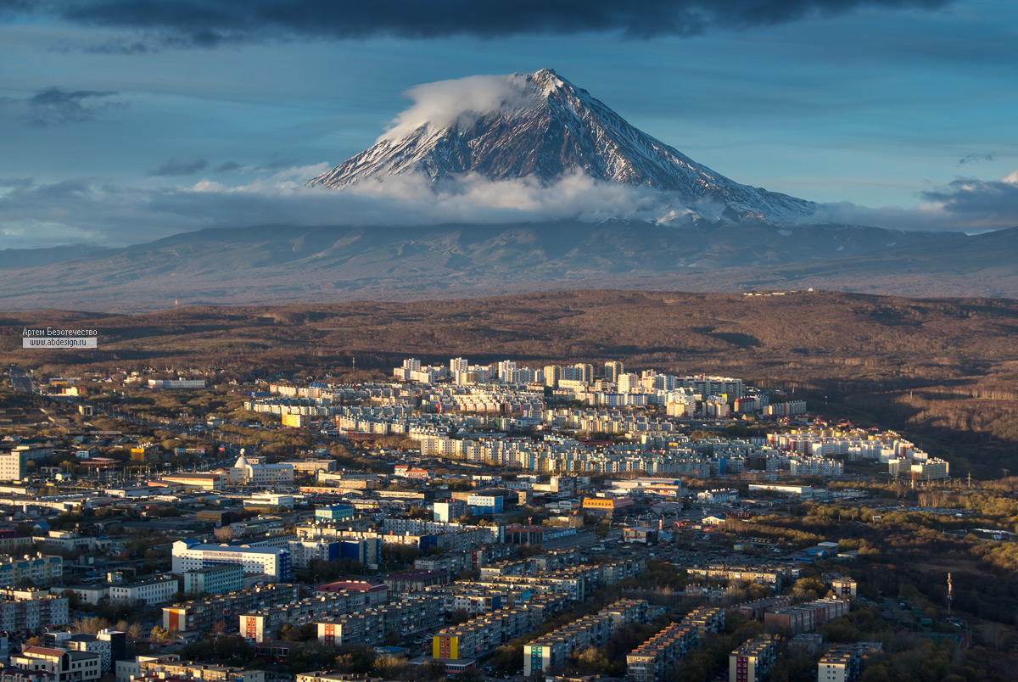
15
RESIDENCE
IF YOU GO TO RUSSIA FOR OUTPATIENT TREATMENT
In case of outpatient treatment, you can do it yourselfchoose a comfortable stay with the following services:
https://www.booking.com/
https://www.tripadvisor.com/
https://www.airbnb.com/
or ask for help from a tour operator/assistance organization
IF YOU GO TO RUSSIA IN-PATIENT TREATMENT
You can find out the conditions of your accommodation in a medical organization, chosen by you in accordance with the profile of medical care.
Please contact your medical organization in advance for accommodation.

Slide 16
16
IV STEP
APPLY FOR A VISA TO ARRIVE TO RUSSIAССИЮ

Slide 17
17
THE REGULATORY FRAMEWORK
FOR VISAS FOR FOREIGN CITIZENS
In accordance with article 2 of the Federal law of 25 July 2002 No. 115-FZ "On the legal status of foreign citizens in the Russian Federation", a foreign citizen is a natural person who is not a citizen of the Russian Federation and has evidence of citizenship (citizenship) of a foreign state; a stateless person is a natural person who is not a citizen of the Russian Federation and does not have evidence of citizenship (citizenship) of a foreign state.
In accordance with article 25.2 of the Federal law of August 16, 1996 № 114-FZ "On the procedure of departure from the Russian Federation and entry into the Russian Federation" visa can be single, double and multiple.
In accordance with article 25.6 of the Federal law of 16 August 1996 No. 114-FZ "On the procedure for leaving the Russian Federation and entering the Russian Federation" , depending on the purpose of entry of a foreign citizen into the Russian Federation and the purpose of his stay in the Russian Federation, ordinary visas are divided into private, business, tourist, educational, working, humanitarian and entry visas to the Russian Federation for the purpose of obtaining asylum, obtaining a temporary residence permit in the Russian Federation or receiving citizenship of the Russian Federation.
Article 25.9. The foreign citizen or the person without citizenship at entrance to the Russian Federation are obliged to receive and fill a migratory card. The migration card must be surrendered (returned) to the checkpoint through the State border of the Russian Federation at departure of the foreign citizen or the person without citizenship of the Russian Federation.
In accordance with article 18 of section II In the Russian Federation, depending on the purpose of entry of foreign citizens into the Russian Federation and the purpose of their stay in the Russian Federation, there are the following categories of visas: a) diplomatic, b) official, C) ordinary, d) transit, e) temporary resident visa.

Slide 18
18
SELECT THE TYPE OF VISA AND THE DEFINITION PURPOSE OF STAY*
* In accordance with the Annex to the joint order of the Ministry of foreign Affairs of Russia, MVD of Russia and FSB of Russia from December, 27th, 2003 № 19723А/1048/922
TYPE OF VISA: TOURISTPURPOSE OF STAY: TOURISM TARGET
TYPE OF VISA: BUSINESS
PURPOSE OF STAY:
TREATMENT
TYPE OF VISA: PRIVATE
PURPOSE OF STAY:
SPECIAL CASE
VALIDITY:
Up to 30 days
FOR SOMEONE:
Foreigners arriving for tourist purposes on a specialized tour for medical consultations and medical examination
VALIDITY:
Up to 90 days
FOR SOMEONE:
Foreigners arriving for treatment, examination, medical consultations at the invitation of a medical institution (except for targeted tourism for the purpose of treatment) and emergency treatment
VALIDITY:
Up to 90 days
FOR SOMEONE:
Foreigners arriving for emergency treatment or due to serious illness or death of a close relative

Slide 19
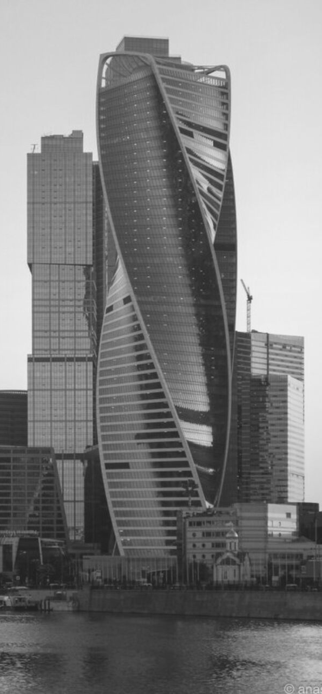
ASSISTANCE IN OBTAINING DOCUMENTATION FOR ENTRY TO RUSSIA
19
THE INVITATION FOR ARRIVAL TO RUSSIA
A medical organization that has confirmed the possibility of Your treatment can issue You an invitation to enter Russia, as well as resolve the issue of migration registration.
For more information please contact Your medical organization.
THE NECESSARY PAPERWORK FOR VISA REQUIREMENTS BY THIRD PARTIES
If the question of Your treatment in Russia is engaged in a tour operator or assistance organization, then instruct the paperwork for a visa to an employee of the organization.

Slide 20
20
V STEP
WELCOME TO RUSSIA!
USEFUL PHONE NUMBERS

Slide 21
21
USEFUL PHONE NUMBERS
Report violations of law and order in the territory of the Kamchatka territory Department of the MIA of Russia on Kamchatka Krai
Hotline of the Federal migration service
Single numberemergency service
112
8 (800) 350 23 69
доб. 381
8 (415) 27-11-02

Slide 22
OUR CONTACT
22
FOR QUESTIONS AND SUGGESTIONS
Coordinating center
development of export of medical services
683003, Kamchatka Krai, ul. Leningrad, d. 118
EMAIL:
ozo@kamgov.ru
CONTACT PHONE NUMBER:
+7 (415) 242-47-02
Fax:
+7 (415) 242-83-77

